Slide 1
Planet Earth

Slide 2
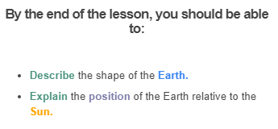


Slide 3
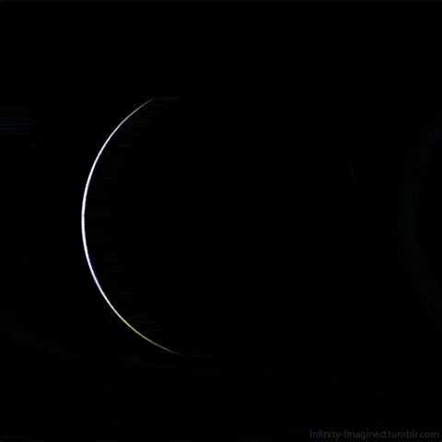
The ground curves beneath us because the Earth is actually round, like a giant ball!

Slide 4
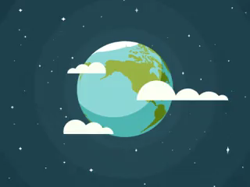
This might seem weird - you could take a ruler and lie it on the ground and find that the ground is flat.
This is because the Earth is so massive that we can't notice it curving under us. We need to look from very far away to be able to see its real shape!

Slide 5
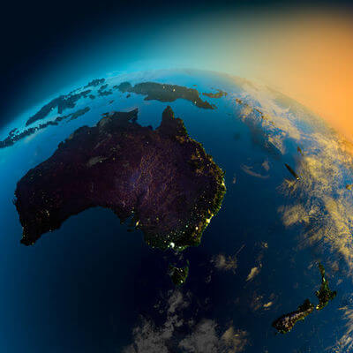
The Earth is round, like an enormous ball.
We say that the Earth is a sphere.
It is so big that we can't see its curve unless we are very far away.

Slide 6
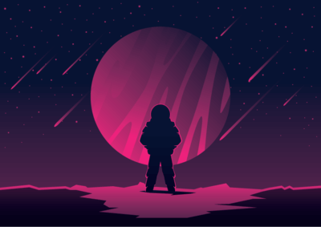
The Earth is a planet.
A planet is a very large, round object that floats in space.

Slide 7
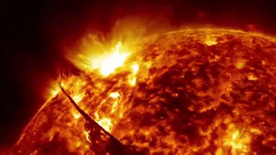
Not every object in space is a planet!
To be a planet, an object also has to be moving around a larger object called a star.
Stars are massive burning balls of gas floating in space.

Slide 8
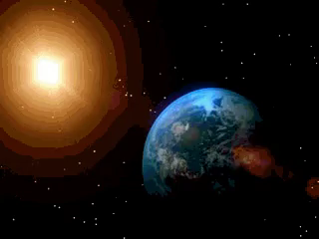
The Sun is also a large, round, floating object, but it's not a planet!
The Sun is a star.
It is very, very far away from the Earth.

Slide 9
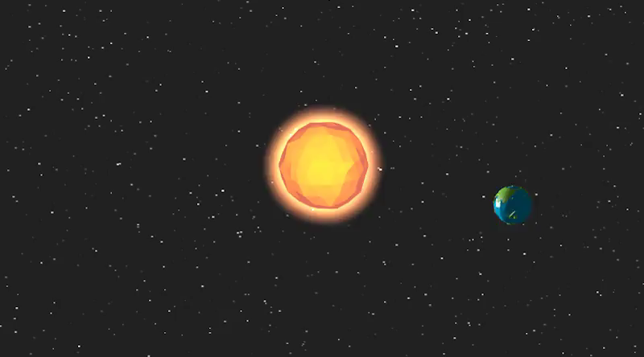
The Earth moves around the Sun.
It takes a really long time for the Earth to move around the Sun (a year, to be exact), because it is so far away from Earth.
Earth's movement around the Sun is called its orbit.

